Slide 1
FRI-based
Polynomial Commitments
VanhGer

Slide 2
Contents
Overview
FRI
FRI-based Polynomial Commitment
Overview of what we have learnt so far.
Describe FRI-based Polynomial Commitments
Fast Reed-Solomon Interactive Oracle Proof of Proximity

Slide 3
OVERVIEW

Slide 4
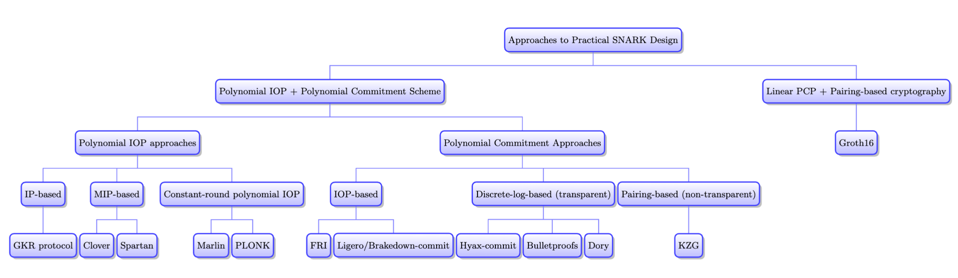
Overview
What we learnt so far

Slide 5
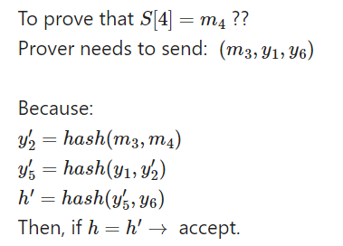
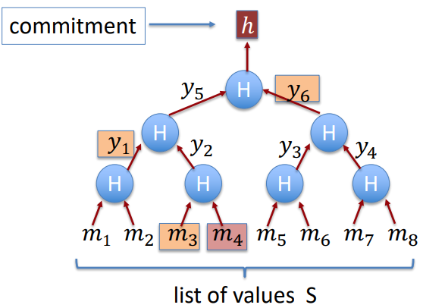
Overview
Merkle Proof
Merkle Tree

Slide 6
FRI
Fast Reed-Solomon Interactive Oracle Proof of Proximity

Slide 7
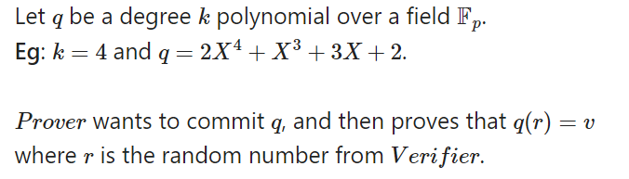
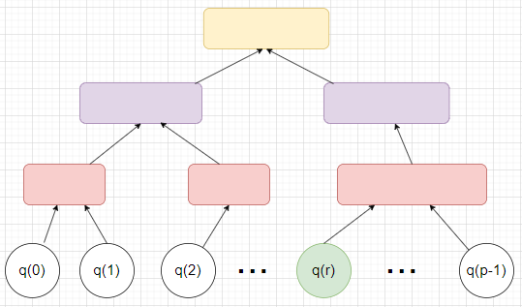
FRI
Simple approach: Prover Merkle-commits to all evaluations of q. Then, when Verifier sends r, Prover sends v = q(r) and proof. However:
Commit all evaluations is impractical. (1)
How Verifier knows that q has degree k. (2)

Slide 8
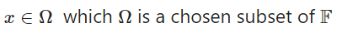
FRI
Commit all evaluations is impractical ??
Instead of commit all evaluations of q, we only Merkle-commits to evaluations q(x) where:

Slide 9
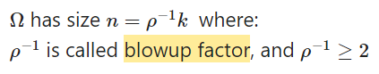
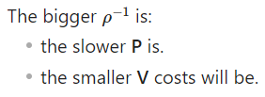
FRI
Commit all evaluations is impractical ??
How many elements in Ω ?
Note that:

Slide 10
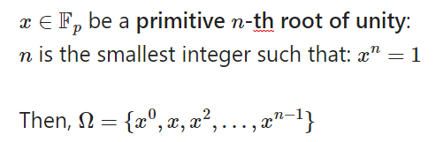
FRI
Commit all evaluations is impractical ??
Which elements in Ω ? (size n)

Slide 11
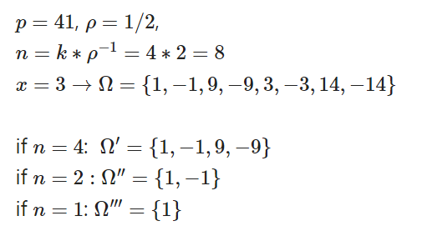
FRI
If reduced k by half, then Ω also reduced by half.
Commit all evaluations is impractical ??

Slide 12
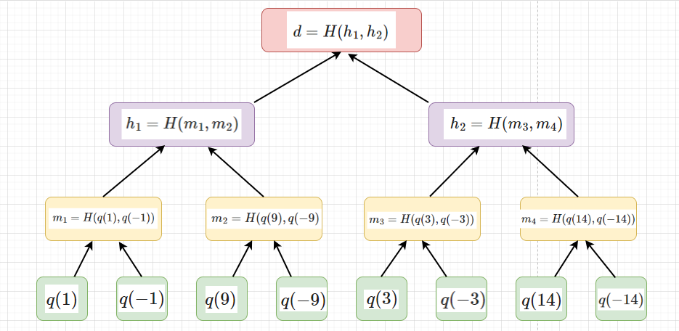
FRI
Commit all evaluations is impractical ??
Then, P just Mekle-commits to evaluations of x in Ω

Slide 13
FRI
(2) Verify that q has degree k
Using Low-degree test technique, consists of a folding phase + query phase
Folding phase: log(k) rounds
Query phase: 1 rounds

Slide 14
FRI
(2) Verify that q has degree k
Folding: (logk) rounds
Repeat:
Round0:
- P merkle-commits q -> sends Merkle proof
Round1:
- V sends a random r1
- P reduces the degree of q by half using r1 -> q1
- P merkle-commits q1 -> sends Merkle proof
Round2:
- V sends a random r2
- P reduces the degree of q1 by half using r2 -> q2
- P merkle-commits q2 -> sends Merkle proof
……
After at most log(k) + 1 rounds, the degree of the polynomial should fall to 0. Then, the final polynomial should be a constant.

Slide 15
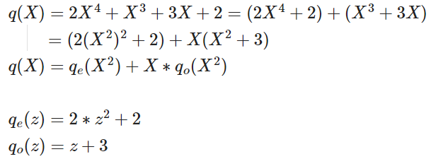
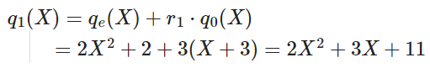
FRI
(2) Verify that q has degree k
Folding:
Round1: V sends a random r1 = 3
Then, Prover computes q1:

Slide 16
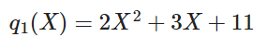
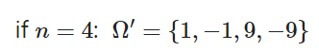
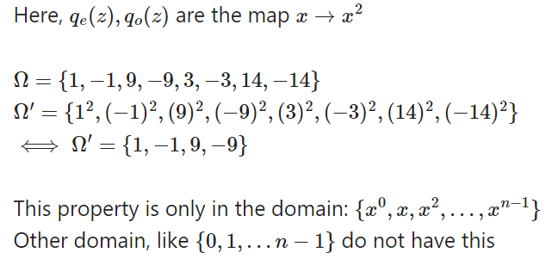
FRI
(2) Verify that q has degree k
Folding:
Round1:
Merkle-commit
Prover commits q1 in the field Ω’:
So, after a round, the number of leaves of the Merkle Tree will be reduced by half.

Slide 17
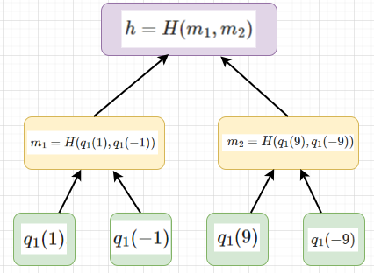
FRI
(2) Verify that q has degree k
Folding:
Round1:
Merkle-commit
Prover commits q1 in the field Ω’:

Slide 18
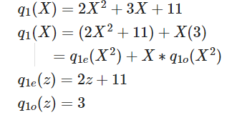
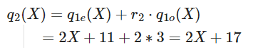
FRI
(2) Verify that q has degree k
Folding:
Round2: V sends a random r2 = 2
Then, Prover computes q2:

Slide 19
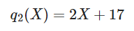
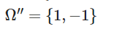
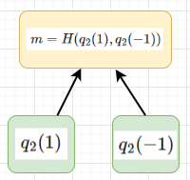
FRI
(2) Verify that q has degree k
Folding:
Round2:
Merkle-commit
Prover commits q2 in the field Ω’’:

Slide 20
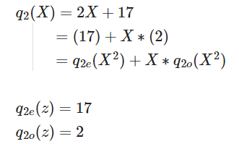
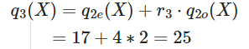
FRI
(2) Verify that q has degree k
Folding:
Round3: V sends a random r3 = 4
Then, Prover computes q3:

Slide 21
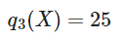
FRI
(2) Verify that q has degree k
Folding:
Round3:
Plaintext-commit
Prover commits q3.

Slide 22
FRI
(2) Verify that q has degree k
Folding:
After each round, the number of leaves of Merkle tree will be reduced by half

Slide 23
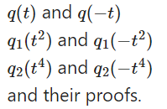
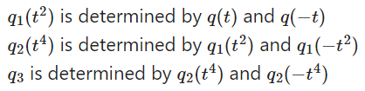
FRI
(2) Verify that q has degree k
Query phase:
Check whether P did the folding phase exactly ?
V queries at a random t in Ω
Prover sends:
Then, Verifier checks round-by-round consistency:
Logk polynomials and its proof will be sent

Slide 24
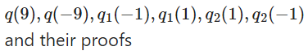
FRI
(2) Verify that q has degree k
Query phase:
Example: t = 9. Prover sends:

Slide 25
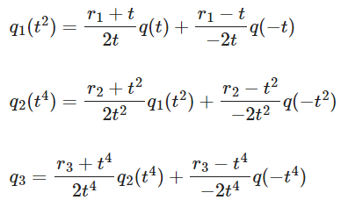
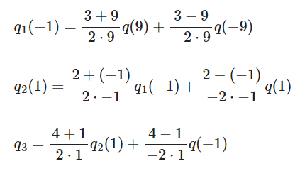
FRI
(2) Verify that q has degree k
Query phase:
Then, Verifier checks consistency:

Slide 26
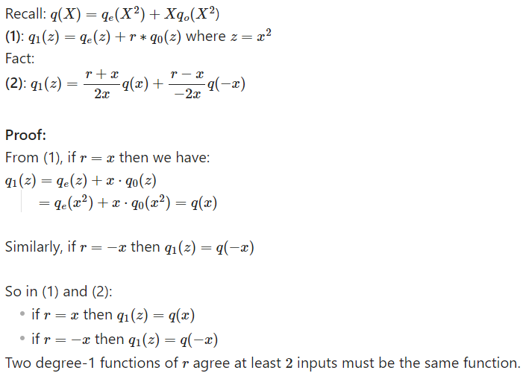
FRI
(2) Verify that q has degree k
Query phase:
Why ???

Slide 27
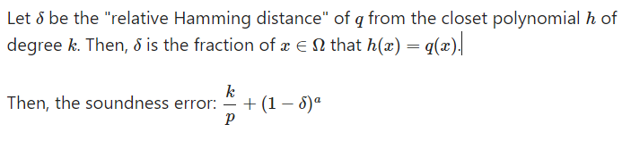
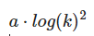
FRI
(2) Verify that q has degree k
Query phase:
Check whether P did the folding phase exactly ?
After querying a certain number of times a, V accepts that q has degree at most k.
Soundness errors:
Proof size:

Slide 28
FRI
So, for now, FRI help us:
Reduce the number of evaluations committed into Merkle-Tree.
Check whether the polynomial has the degree at most k
Now, let’s apply FRI to the polynomial commitment scheme.

Slide 29
FRI-BASED
POLYNOMIAL COMMITMENT

Slide 30
FRI-based Polynomial Commitment
Problem:
Prover have a degree-d polynomial p. He wants to commit p. Then, Verifier sends a random r, Prover will send value v = p(r) and a proof about it.
Solution:
Prover Merkle-commits to p(x) where: x ∈ Ω
Then, if Verifier queries a random r that r ∈ Ω, Prover can easily sends the value v = p(r) and their proofs.
However, if r not ∈ Ω, how can Prover create a proofs for it?

Slide 31
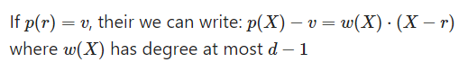
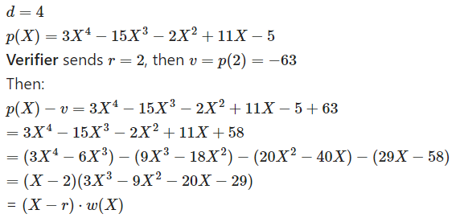
FRI-based Polynomial Commitment
If Verifier queries a value r that’s not in Ω
For example:

Slide 32
FRI-based Polynomial Commitment
If Verifier queries a value r that’s not in Ω
So, to give the proof that p(r) = v, Prover now need to verify that there exists a polynomial w of degree at most d -1 satisfying the equation above.
To do that, Prover now will apply FRI to get the proof.

Slide 33
Thank for your listening

